Slide 1


Nandeesh vinnakota
Final project

Slide 2





KEYLOGGER & SECURITY

Slide 3
AGENDA
Section 1: Introduction to Keyloggers
Section 2: Types of Keyloggers
Section 3: Ensuring Security Against Keyloggers
Section 4: Importance of Cybersecurity

Slide 4
What are Keyloggers?
Definition: Keyloggers are tools that can record every keystroke that you type into a computer or mobile keyboard, potentially capturing sensitive information such as passwords, credit card numbers, and personal messages.
Functionality: The keylogger program records each keystroke the user types and periodically uploads the information over the internet, where the hacker can then access it, posing a significant threat to personal and organizational security.
Risks and Implications: Keystroke logging is an act of tracking and recording every keystroke entry made on a computer, often without the permission or knowledge of the user, leading to potential data breaches and identity theft.

Slide 5
Software Keyloggers: These are computer programs developed to steal passwords and sensitive information from the victim's computer, often installed without the user's knowledge.
Hardware Keyloggers: Physical devices that can be inserted between the keyboard and the computer, intercepting and recording keystrokes without leaving traces in the operating system.
Remote Access Keyloggers: These keyloggers can capture keystrokes from a remote location and transmit the data over the internet to the attacker, making them particularly dangerous

Slide 6
3.1: Continuous Monitoring and Detection
3.2: Incident Response and Recovery
3.3: Collaboration and Information Sharing

Slide 7
PROBLEM STATEMENT:
Cybersecurity is a critical field focused on protecting digital systems, networks, and data from cyber threats. It encompasses technologies, processes, and practices designed to ensure the confidentiality, integrity, and availability of information.

Slide 8
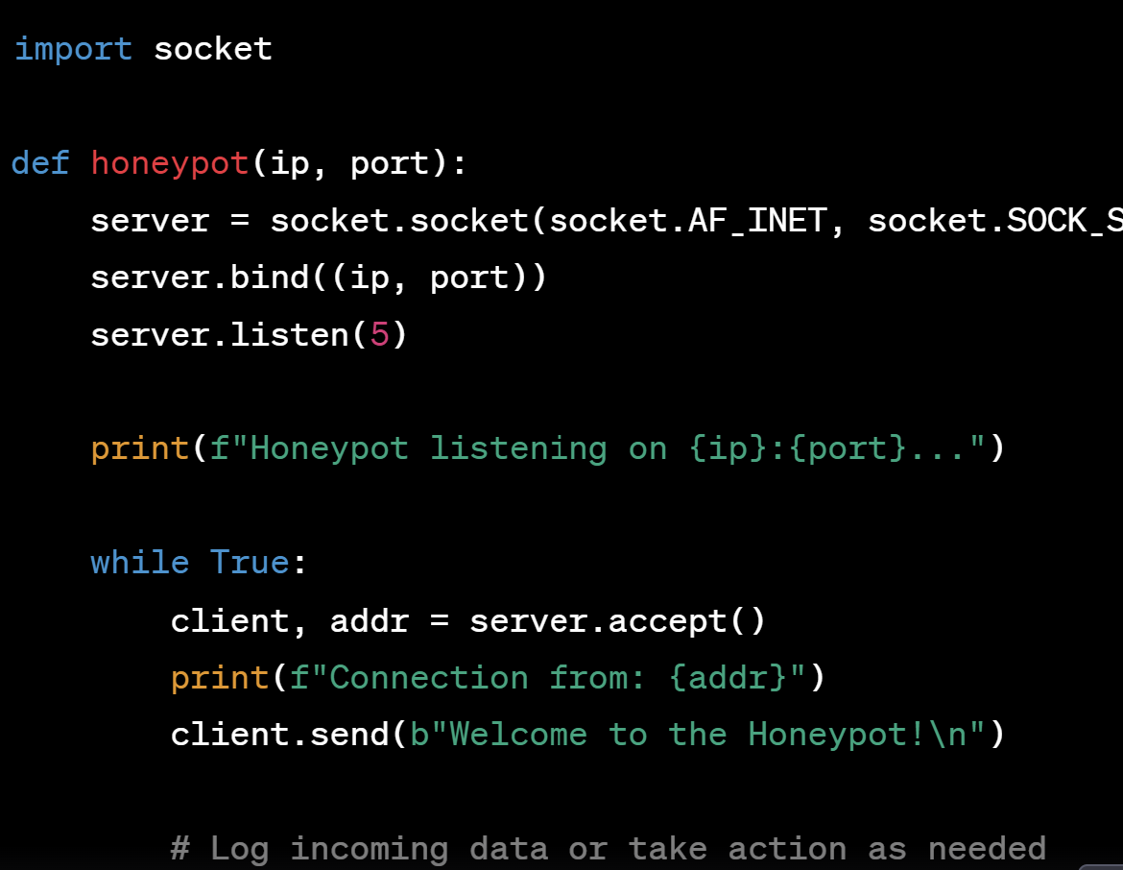
MODELLING

Slide 10
CONCLUSION
Implementing cybersecurity measures for end users enhances data protection and prevents unauthorized access, ensuring confidentiality and operational continuity. This fosters trust, improves productivity, and ensures compliance with regulatory standards

